Slide 1

WELCOME
C I T Y O F T O R R A N C E
CITIZEN DEVELOPMENT AND ENRICHMENT COMMITTEE MEETING
MAY 15, 2024

Slide 2
AGENDA
Call Meeting to Order
Roll Call
Flag Salute
Welcome & Introductions
Items For Discussion
Public Comment
Closing Remarks
Adjournment
C I T Y O F T O R R A N C E
MAY 15, 2024

Slide 3
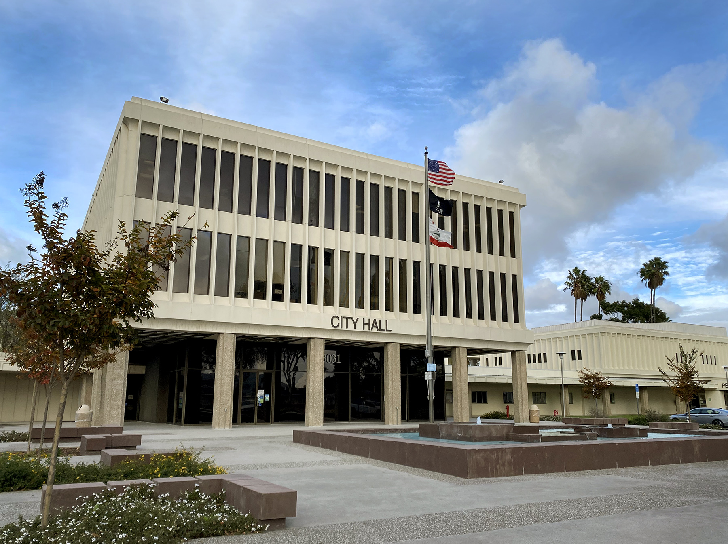
II. ROLL CALL
C I T Y O F T O R R A N C E
MAY 15, 2024

Slide 4

III. FLAG SALUTE
C I T Y O F T O R R A N C E
MAY 15, 2024

Slide 5
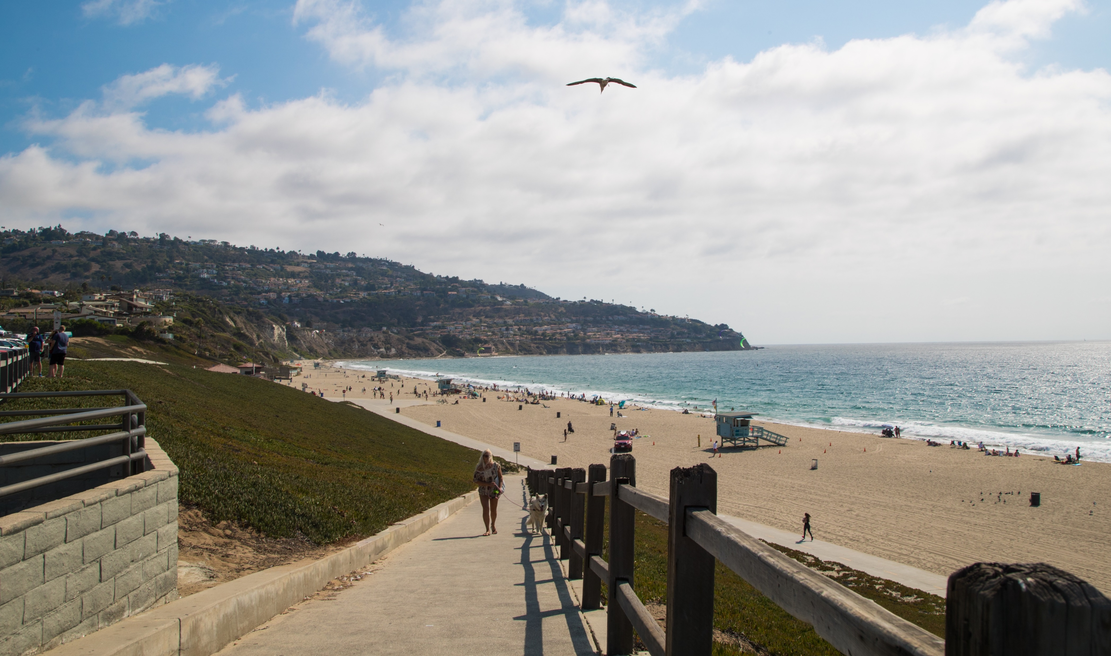
IV. WELCOME & INTRODUCTIONS
C I T Y O F T O R R A N C E

Slide 6
V. ITEMS FOR DISCUSSION
Item 5a
COMMUNITY SERVICES – APPROVE CONCEPTUAL FLOAT DESIGN FOR THE 2025 PASADENA TOURNAMENT OF ROSES PARADE.
C I T Y O F T O R R A N C E
MAY 15, 2024

Slide 7
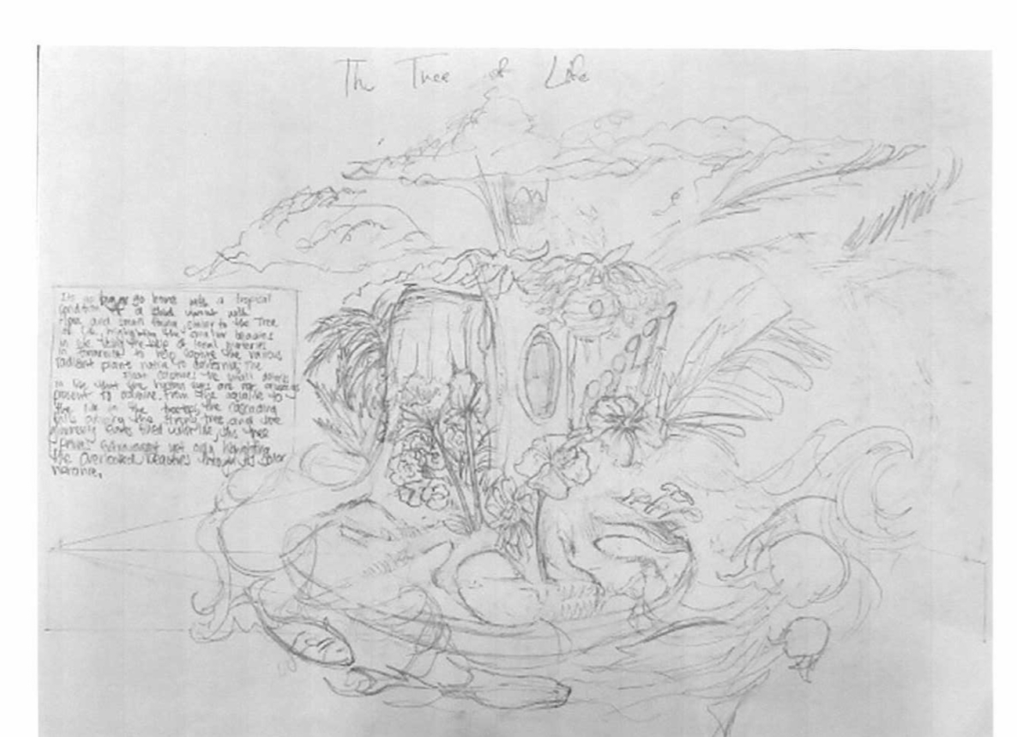
ITEM 5A
C I T Y O F T O R R A N C E

Slide 8
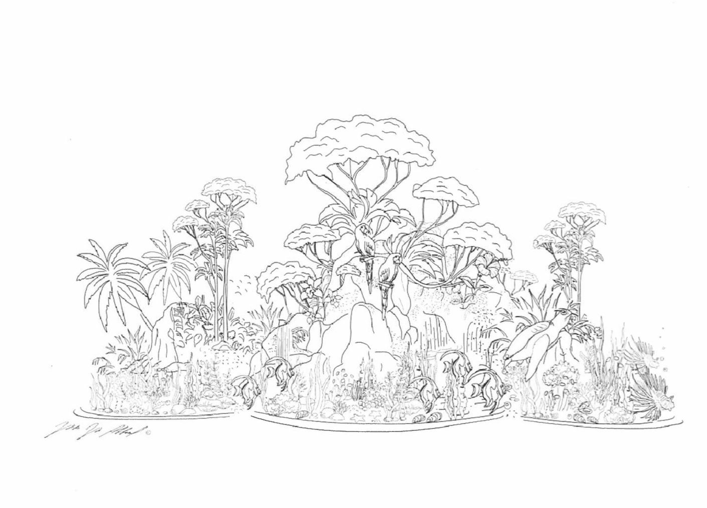
ITEM 5A
C I T Y O F T O R R A N C E

Slide 9
V. ADMIN MATTERS
ITEM 5B
Recommendation of the City Manager that the Citizen Development and Enrichment Committee:
Review and Provide Direction on the Appropriated Resource Contributions to the Neighborhood Coordinated Seaside Ranchos Holiday Lights Display.
Provide Direction to the Cottage Food Ordinance as it relates to the Neighborhood Coordinated Seaside Holiday Lights Display.
C I T Y O F T O R R A N C E

Slide 10
ITEM 5B
Seaside Holiday Lights
Annual neighborhood coordinated light display is not a city-sponsored nor a city-sanctioned event.
Event has attracted large crowds and has created potential safety hazards.
Last year the event was advertised on local radio stations, websites, and the broadcast news because of its long-time tradition and growing popularity. No formal advertising was done by the City or the residents.
Although this is not a City event, the City of Torrance does have an obligation to address public safety concerns.
Since 2018 the City has appropriated resources to address the concerns.
C I T Y O F T O R R A N C E

Slide 11
ITEM 5B
Anticipated Resources
for 2024
Temporary no stopping signs.
Posting of holiday directional signs.
Monitoring of no stopping and holiday directional signs all season during the holiday lights display.
20 trash bins and coordinated additional pick-ups.
Two illuminated light boards to assist with traffic control and inform visitors of parking restrictions.
C I T Y O F T O R R A N C E

Slide 12
ITEM 5B
Anticipated Resources
Continued...
Public Works Page for Seaside Ranchos Residents and Visitors included information regarding:
City Contact
Parking Violations
LA County Public Health Mobile Food Program
Sanitation/Trash Bins
Traffic and Signage
Code Enforcement
C I T Y O F T O R R A N C E

Slide 13
ITEM 5B
C I T Y O F T O R R A N C E
Based on the 2023 Season, we anticipate an
increase in labor cost predominately due to Police and Code Enforcement. 2023 was the first season the City dedicated CEOs to the area.

Slide 14
ITEM 5B
Cottage Food Ordinance Pilot Program
Expired in January 2022
Designated for residents of the Seaside Ranchos area to sell approved food items from their driveway in accordance with the Cottage Food Home Occupations Ordinance if they obtained the proper requirements.
2022 Holiday Season
As a courtesy, the season was utilized to educate vendors of the Pilot Program expiration with the intent to administer citations during the 2023 Holiday Season.
2023 Holiday Season
Distributed approximately 200 doorhangers to residents within the Seaside Holiday Lights Neighborhood regarding cottage food permits and vending violations.
C I T Y O F T O R R A N C E

Slide 15
ITEM 5B
The Community Development Department provided Code Enforcement Officers (CEOs) for the 2023 Seaside Holiday Lights.
Time Period: December 1st to December 30th
Coverage Hours: 5 pm to 9 pm, daily
Except on December 24th, 25th, and 31st due to the holidays
The total public contact during the event was approximately 80 interactions (most repeat violators).
C I T Y O F T O R R A N C E

Slide 16
ITEM 5B
Challenges included:
Cottage Food Non-Compliance
Residents possessing a cottage food permit did not follow the regulations
Limited number of CEOs to work the area.
CEOs dealing with one issue pulled directly to another issue
Keeping up with the unpermitted vendors
C I T Y O F T O R R A N C E

Slide 17
ITEM 5B
Challenges Continued…
Lack of Enforcement Abilities
CEOs do not have the authority to confiscate merchandise.
Identification Refusal
CEOs could not hold the vendors accountable.
After Hours Violations
Vendors would return and continue selling after 9 pm.
C I T Y O F T O R R A N C E

Slide 18
ITEM 5B
Cottage Food Ordinance
Direct sales are not allowed from an attached garage, accessory residential structure, or any place outside of the residential home.
Hours direct sales are only allowed from the home is 9 am to 5 pm.
2023 Holiday Season, there was an exception to allow cottage food sales within the front yard of the property from 5 pm to 9 pm.
If this is something that the City Council would like to continue, then the ordinance needs to be amended.
C I T Y O F T O R R A N C E

Slide 19
ITEM 5B
Recommendation of the City Manager that the Citizen Development and Enrichment Committee:
Review and Provide Direction on the Appropriated Resource Contributions to the Neighborhood Coordinated Seaside Ranchos Holiday Lights Display.
Provide Direction to the Cottage Food Ordinance as it relates to the Neighborhood Coordinated Seaside Holiday Lights Display.
C I T Y O F T O R R A N C E

Slide 20
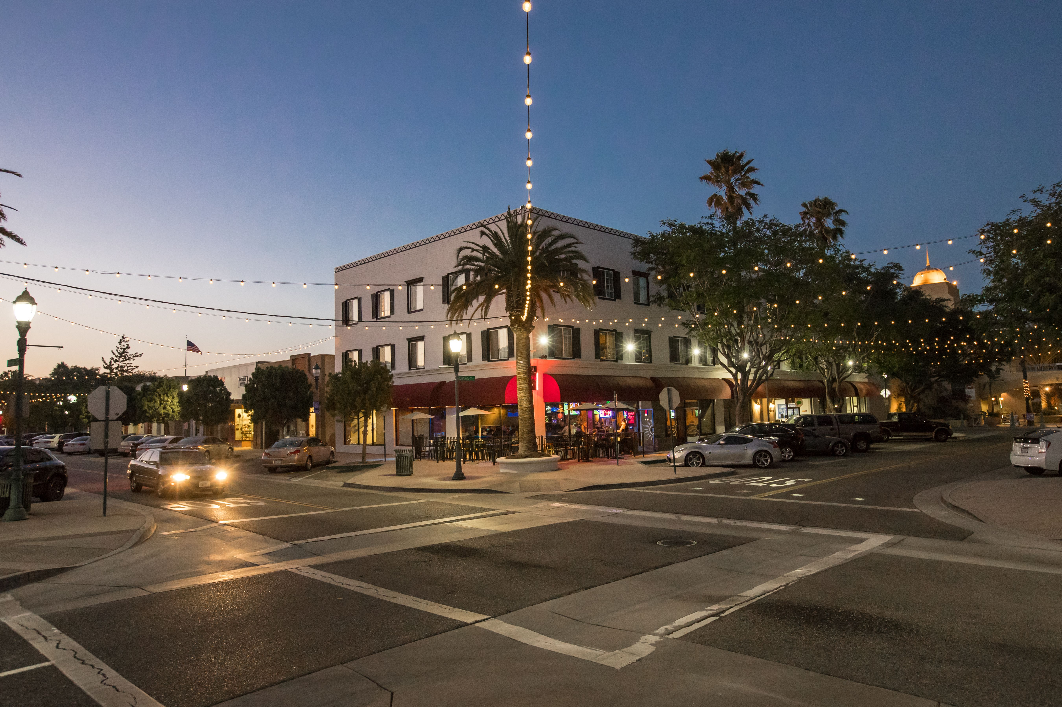
VI. PUBLIC COMMENT
C I T Y O F T O R R A N C E

Slide 21
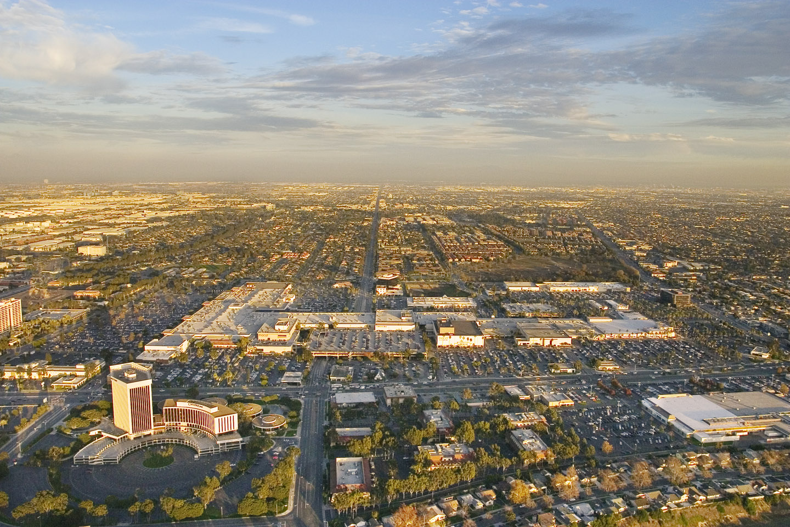
VII. CLOSING REMARKS
C I T Y O F T O R R A N C E

Slide 22
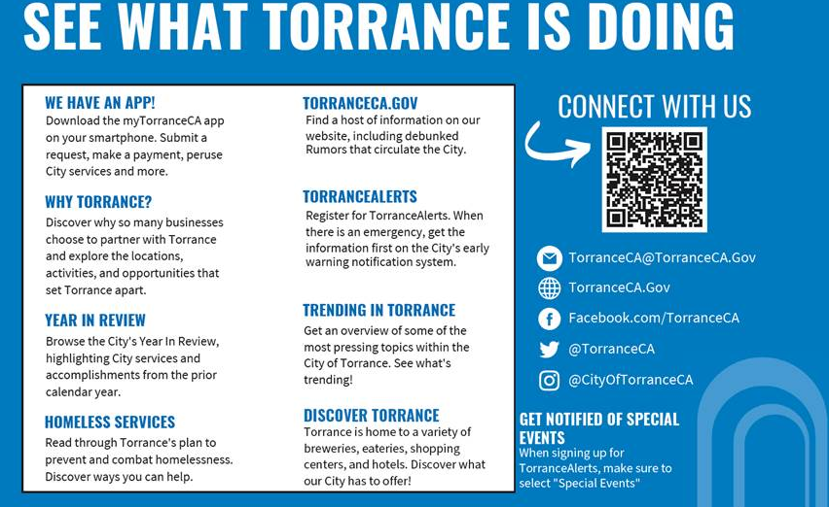
VIII. ADJOURNMENT
C I T Y O F T O R R A N C E

